Slide 1
988 Suicide & Crisis Lifeline
Anniston City Schools
School Safety & Mental Health Training 22-23

Slide 2
988 is now the national three-digit phone number for all mental health, substance use, and suicide crises, as of July 16, 2022.
988 calls are routed to the National Suicide Prevention Lifeline centers in each state, transitioning from the current Lifeline number, 1-800-273-8255.
988 offers rapid access to behavioral health support through connection with trained crisis specialists.
988 is more than just an easy-to-remember number—it’s a direct connection to compassionate, accessible care and support for anyone experiencing mental health-related distress – whether that is thoughts of suicide, mental health or substance use crisis, or any other kind of emotional distress. People can also dial 988 if they are worried about a loved one who may need crisis support.

Slide 3
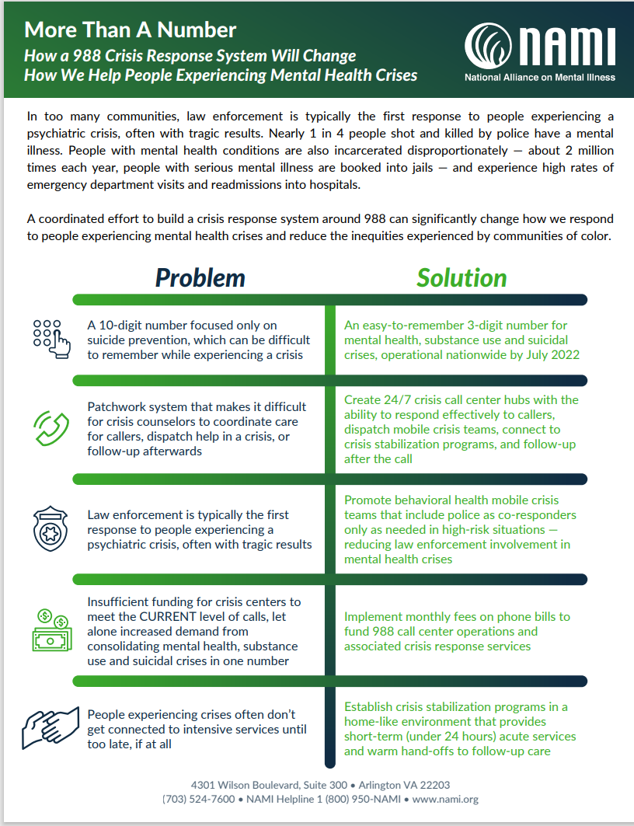
So, what’s different?
988 offers a once-in-a-lifetime opportunity to decouple policing from a mental health or substance use crisis.
988 is a safety net for people experiencing a mental health emergency.

Slide 4
988 is a robust crisis system that can de-escalate mental health crises and connect individuals to the most appropriate care.
With 988 as the first component of our system, we hope to see:
A change in the community response to behavioral health crises
A decrease in suicides and other poor mental health outcomes
A reduction in health care spending and use of law enforcement with more cost-effective early intervention

Slide 5
How will it work?
When someone calls, chats, or texts 988, they are connected to a crisis specialist who is trained and prepared to deliver support to anyone experiencing a crisis. Because a crisis is defined by the person or family experiencing it, the crisis specialist addresses the person’s unique concerns and needs.
The conversation may include assessment, stabilization, referral, and follow-up for individuals at high risk for suicide and/or poor mental health outcomes. If a higher level of care is needed, the crisis specialist works with the caller to connect them to a mobile crisis response team to respond to the person in the community, inform them of the nearest Crisis Center or relay the call to emergency responders, if needed.

Slide 6
When Should You Call 988?
Anyone in need of crisis support for themselves or someone else should call 988.
Veterans can push 1 for direct access to specific assistance.
In Alabama, calls are answered by centers right here in the state. The call centers are located in Mobile, in Birmingham and Huntsville
988 is interwoven into the Alabama Crisis System of Care, as the first step and response in a crisis.

Slide 7
Alabama’s 988 Commission
The purpose of the 988 Comprehensive Behavioral Health Crisis Communication System Commission (typically called the 988 commission), created by Act 2021-359, is to study and provide recommendations for the implementation of the 988 system to enhance and expand behavioral health crisis response and suicide prevention services before it is nationally implemented on July 16, 2022, as required by Public Law No: 116-172.
While 988 is available nationally, each state will continue to work to ensure crisis services are adequately funded and available to their citizens. Alabama's 988 Commission is continuing to develop a long term 988 plan and exploring long-term funding options for the sustainment of 988.

Slide 8
For more information
988 – Alabama Department of Mental Health
988 Suicide & Crisis Lifeline | SAMHSA
Lifeline (988lifeline.org)

